Slide 1
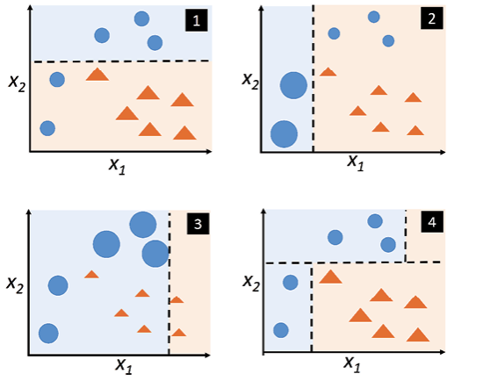
Adaptive boosting
AdaBoost initially gives the same weight to each dataset. Then, it automatically adjusts the weights of the data points after every decision tree. It gives more weight to incorrectly classified items to correct them for the next round. It repeats the process until the residual error, or the difference between actual and predicted values, falls below an acceptable threshold.

Slide 2
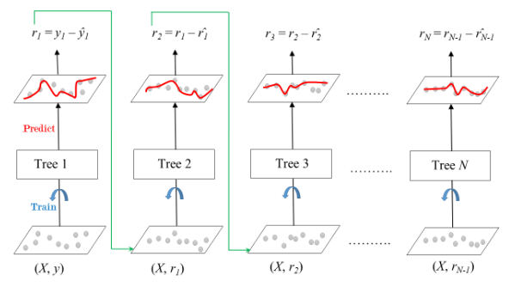
Gradient boosting
Gradient Boosting (GB) is similar to AdaBoost in that it, too, is a sequential training technique. The difference between AdaBoost and GB is that GB does not give incorrectly classified items more weight. Instead, GB software optimizes the loss function by generating base learners sequentially so that the present base learner is always more effective than the previous one. This method attempts to generate accurate results initially instead of correcting errors throughout the process, like AdaBoost. For this reason, GB software can lead to more accurate results. Gradient Boosting can help with both classification and regression-based problems.

Slide 3
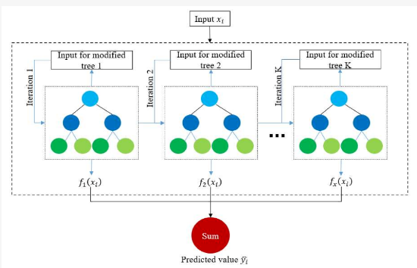
Extreme gradient boosting
Extreme Gradient Boosting (XGBoost) improves gradient boosting for computational speed and scale in several ways. XGBoost uses multiple cores on the CPU so that learning can occur in parallel during training. It is a boosting algorithm that can handle extensive datasets, making it attractive for big data applications. The key features of XGBoost are parallelization, distributed computing, cache optimization, and out-of-core processing.

Slide 4
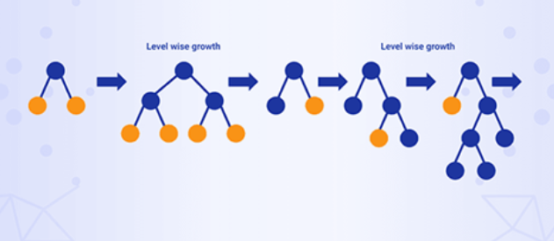
Light gradient boosting
Light gradient boosting machine in short LGBM is a framework and a variant of gradient boosting. Like another gradient boosting Light GBM is also based on Decision tree algorithms. With the help of Light GBM, we can reduce memory usage and can increase efficiency.
The main difference between Light GBM and other gradient boosting frameworks is that Light GBM expands in a vertical direction means it grows leaf-wise. While the other algorithms expand horizontally in a level-wise direction. Light GBM selects the leaf which produces the least error and maximum efficiency. This method is way more helpful in reducing the error percentage. In short, it grows leaf-wise while others expand level-wise.

